Slide 1
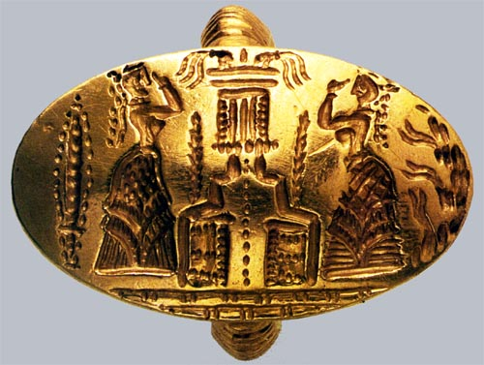
Lecture 10
Chemical Engineering for Micro/Nano Fabrication
Minoan Signet Ring
From the Bronze Age

Slide 2
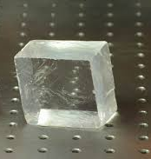
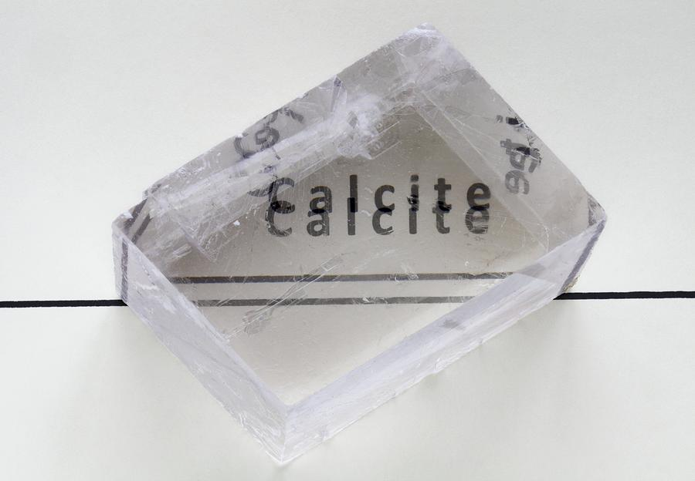
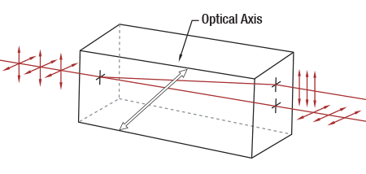
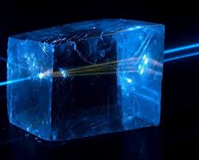
Birefringent Crystals
CaF₂
CaCO₃

Slide 3

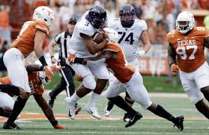
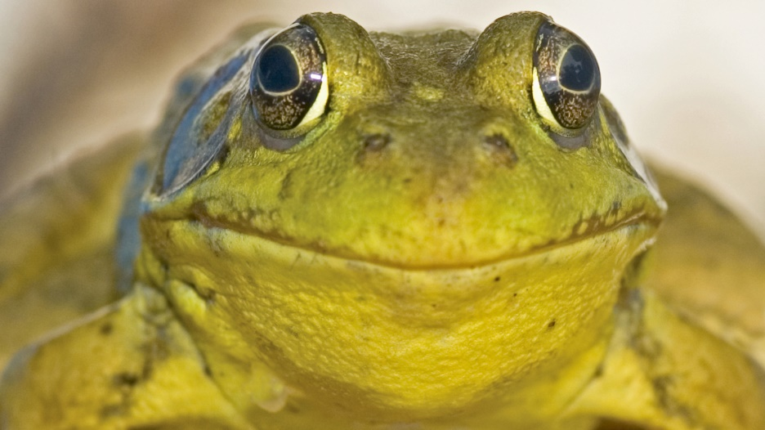
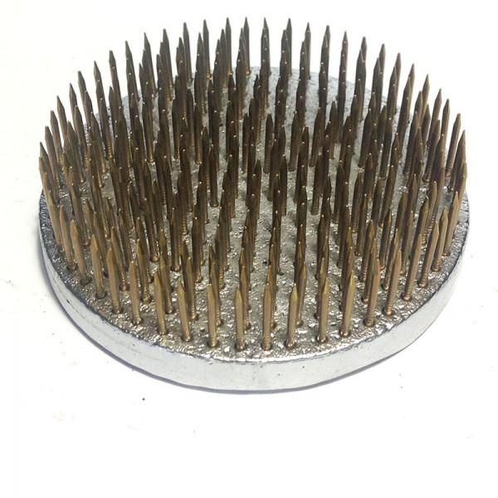
Frogs

Slide 4
Pattern Density Effects
Easiest… Easy… Very Difficult!
“Residual layer”

Slide 5

Step and Flash Imprint Lithography
Fused silica template, coated with release layer
S-FIL fluid dispenser
Ink jet system
Template
Step 1: Dispense drops
Planarization layer
Substrate
Step 2: Lower template and fill pattern
Template filling driven by capillary action
low imprint pressure and room temperature process
Template
Planarization layer
Substrate
Step 3: Polymerize S-FIL fluid with UV exposure
Planarization layer
Substrate
Step 4: Separate template from substrate
Template
Step & Repeat
Planarization layer
Substrate
Notes:
So how does the technology work. Well before I go into the details of SFIL, lets talk about imprint technology in general. It had its genesis I suppose with the wax seals that the Chinese invested to authenticate documents, and the same thermoplastic process has been used in the past decade to make very high resolution lithography patterns – with Stephen Chou at Princeton leading the way. However, any thermal process is an absolute non starter in the CMOS industry since it makes accurate overlay impossible. The next alternative was to use a UV curable film spun onto the wafer, but now you have the challenge of moving a relative high viscosity material between the various patterns on the template, so Grant and SV came up with the idea of using a low viscosity monomer placed on the surface of the wafer.
This slides shows a schematic animation of the SFIL process:
Points to make – template is common with photolithography – smaller dimensions yes, but otherwise common to allow commercial supply – no membranes per previous NGL efforts
- process leaves a very thin film which can be removed in an etch descum. ie the process is compatible with etch. Thus the upstream template and the down stream etch and compatible. Just replace the litho cell.
- some application are whole wafer

Slide 6
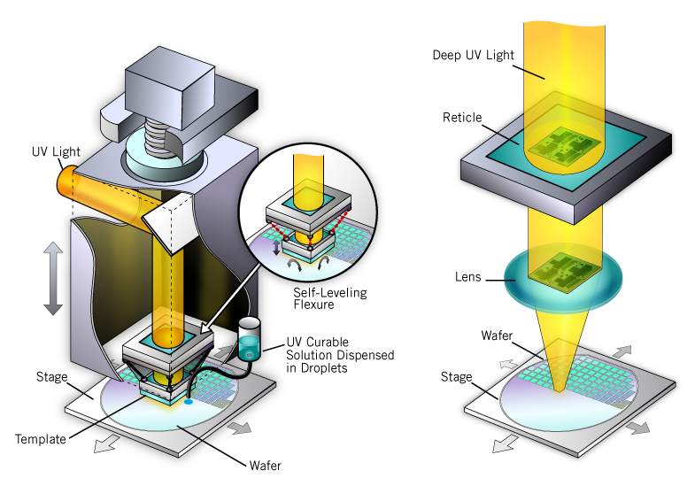
S-FIL vs. Optical Lithography Schematic
Greatly simplified and lower cost process
Imprint Lithography
Standard Optical Lithography

Slide 7
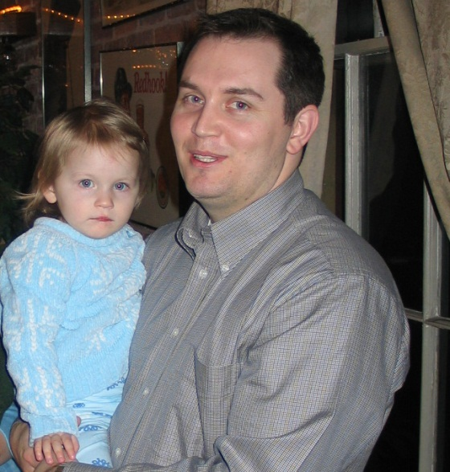
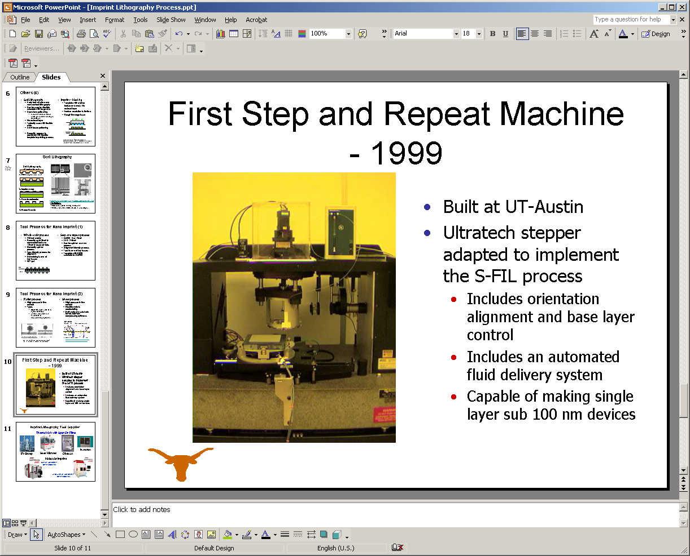
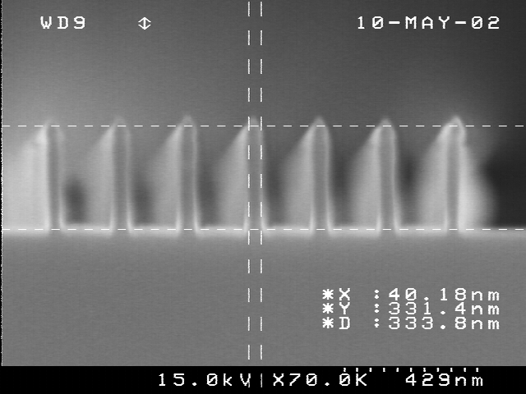
First Publication of SFIL
Colburn, et.al “Step and Flash Imprint Lithography: A New Approach to High-Resolution Patterning,” Proc. SPIE 3676 379-389 (1999)
Matt Colburn, et. al
40 nm images
First SFIL tool

Slide 8
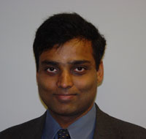
“Issues” with SFIL are:
Templates
  Orientation control
  Making 1X templates
Residual layer control
Defects
  Template wear
Alignment
Throughput
Templates
  Orientation control
  Making 1X templates
Residual layer control
Defects
  Template wear
Alignment
Throughput
Residual Layer
S.V. Sreenivasan

Slide 9
Self-Leveling Scheme using Template Flexure
Flexure Schematic
Z head
Template
calibration stage
Template
flexure
Template-substrate interface
Template
Template
chuck
Remote center
of rotation
B. J. Choi, S. Johnson, M. Colburn, S.V. Sreenivasan, C. G. Willson, “Design of Orientation Stages for Step and Flash Imprint Lithography,” Journal of Int. Societies for Precision Engineering and Nanotechnology, Volume 25, No. 3, pp. 192-199, July, 2001.
Template
Wafer
Wafer Tip/Tilt stage
Theta stage
XY stage

Slide 10
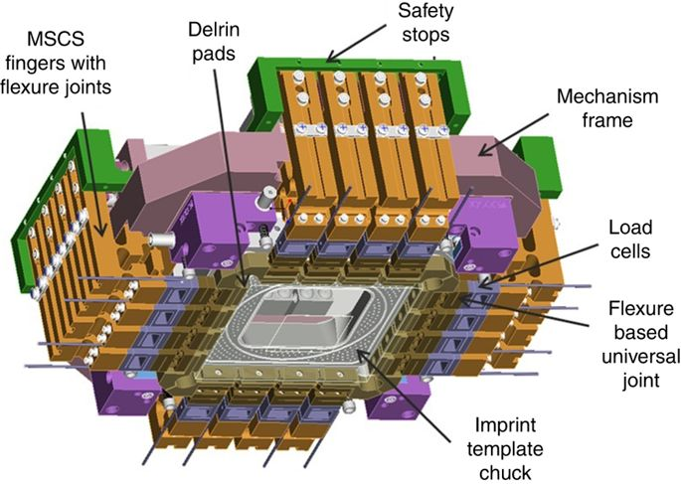
Modern Imprint Head…MII and Canon

Slide 11
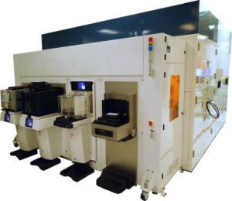
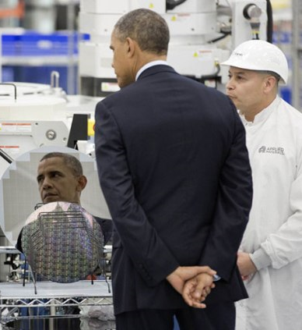
SFIL tool decade later

Slide 12
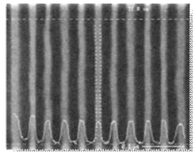
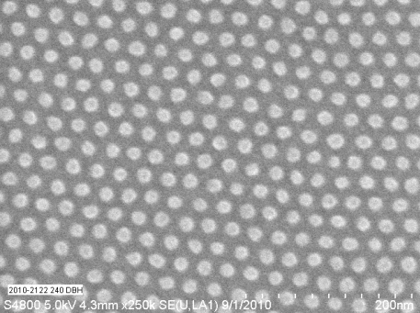
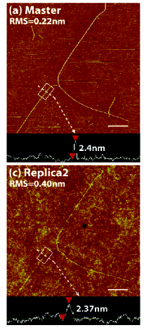
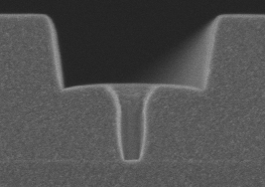
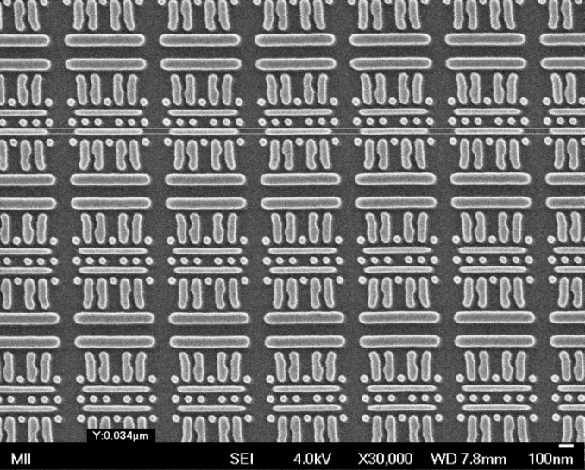
SFIL Lithography
2nm Replication
(Rogers et al, Illinois)
11nm lines and spaces
14 nm posts
Line and 100 nm via
26 nm metal 1
Notes:
This process provides remarkable resolution. Essentially, what ever can be put into the template can be replicated in this process. It is possivle to copy 2 nm images as shown, images that have more than one level and lines and dots simultaneously.

Slide 13
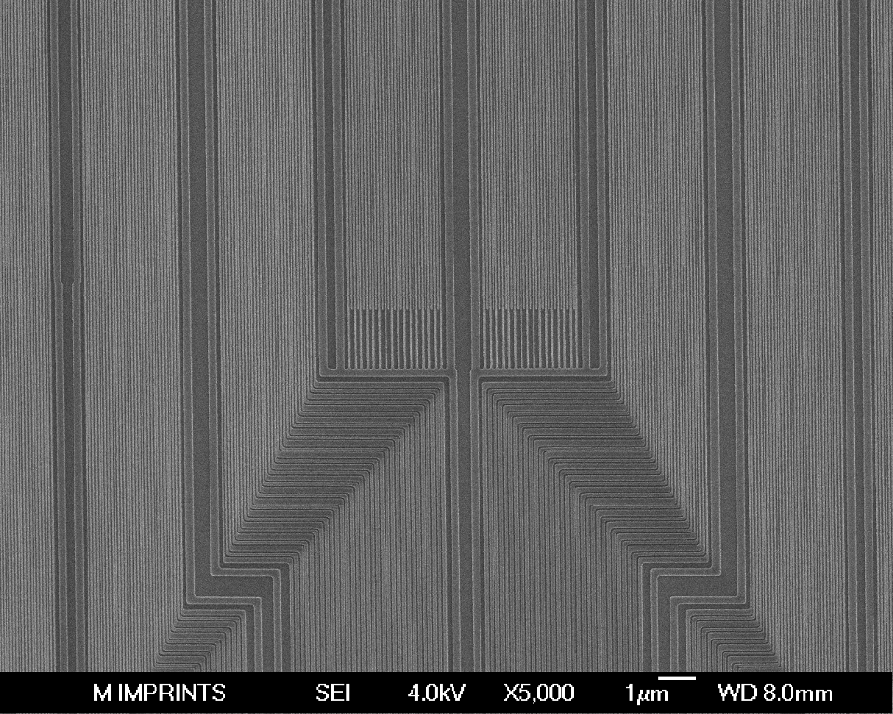
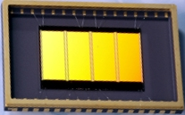
Gate Level: 38nm Half Pitch

Slide 14
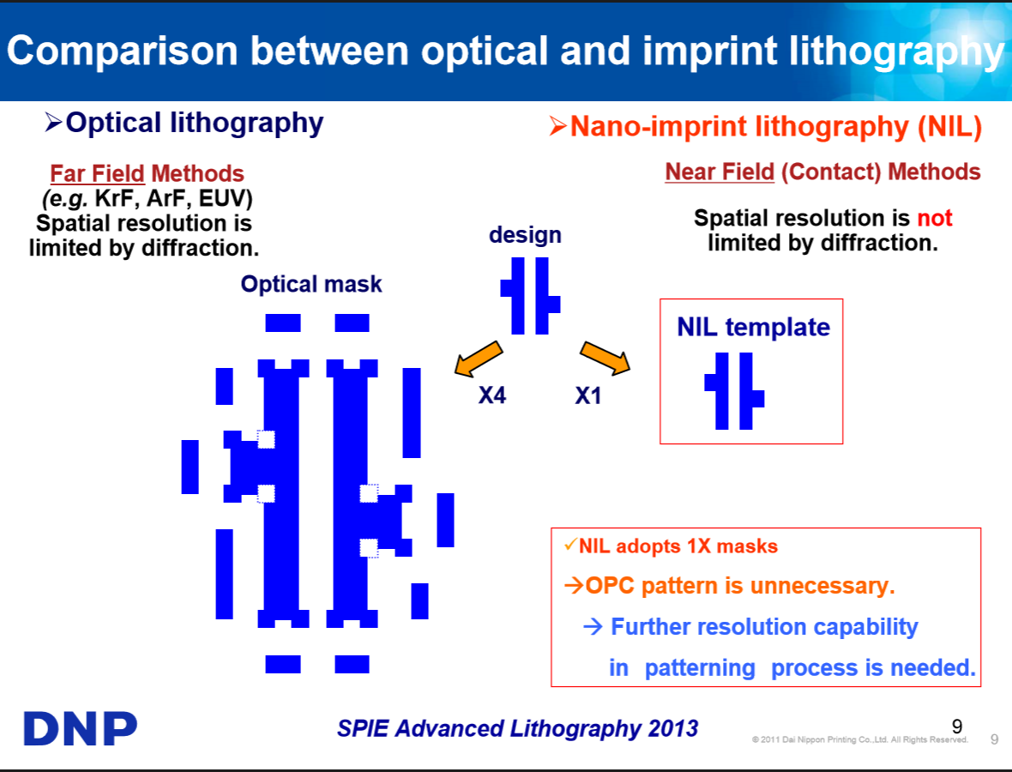

Slide 15
Claims of competitors and detractors
Obviously, you cannot …….
control residual layer thickness
manage defects….no pellicle???
achieve layer to layer alignment
achieve workable throughput
Abut fields, etc, etc.

Slide 16
Residual Layer Thickness Control
Residual Layer is due to the inevitable undisplaced liquid
Residual Layer
Avoid: Non-uniformities
Residual Layers
Residual layer needs to be thin and uniform

Slide 17
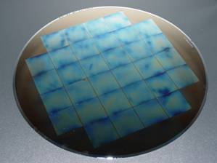
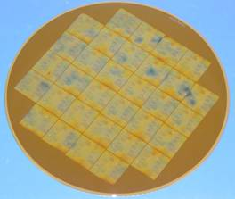
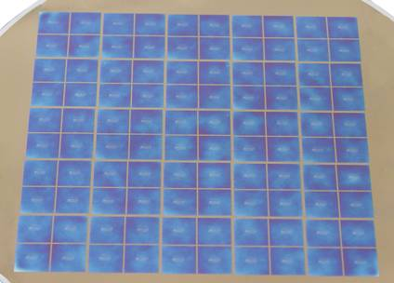
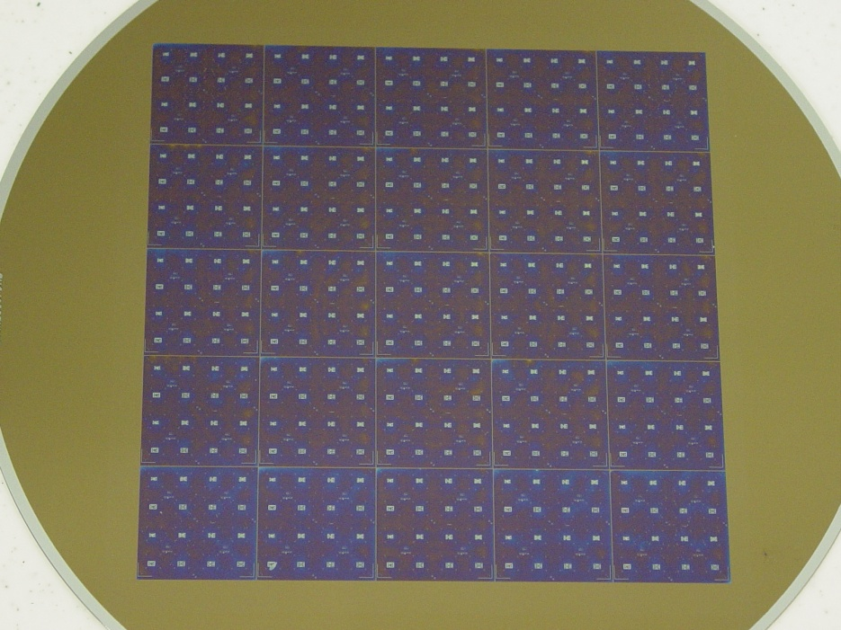
Focus on Continuous Process Improvement
1.
2.
3.
4.
  Minimize mean and standard deviation of residual layer
  Key drivers: chuck flatness, inkjet drop volume and location controls, evaporation.

Slide 18
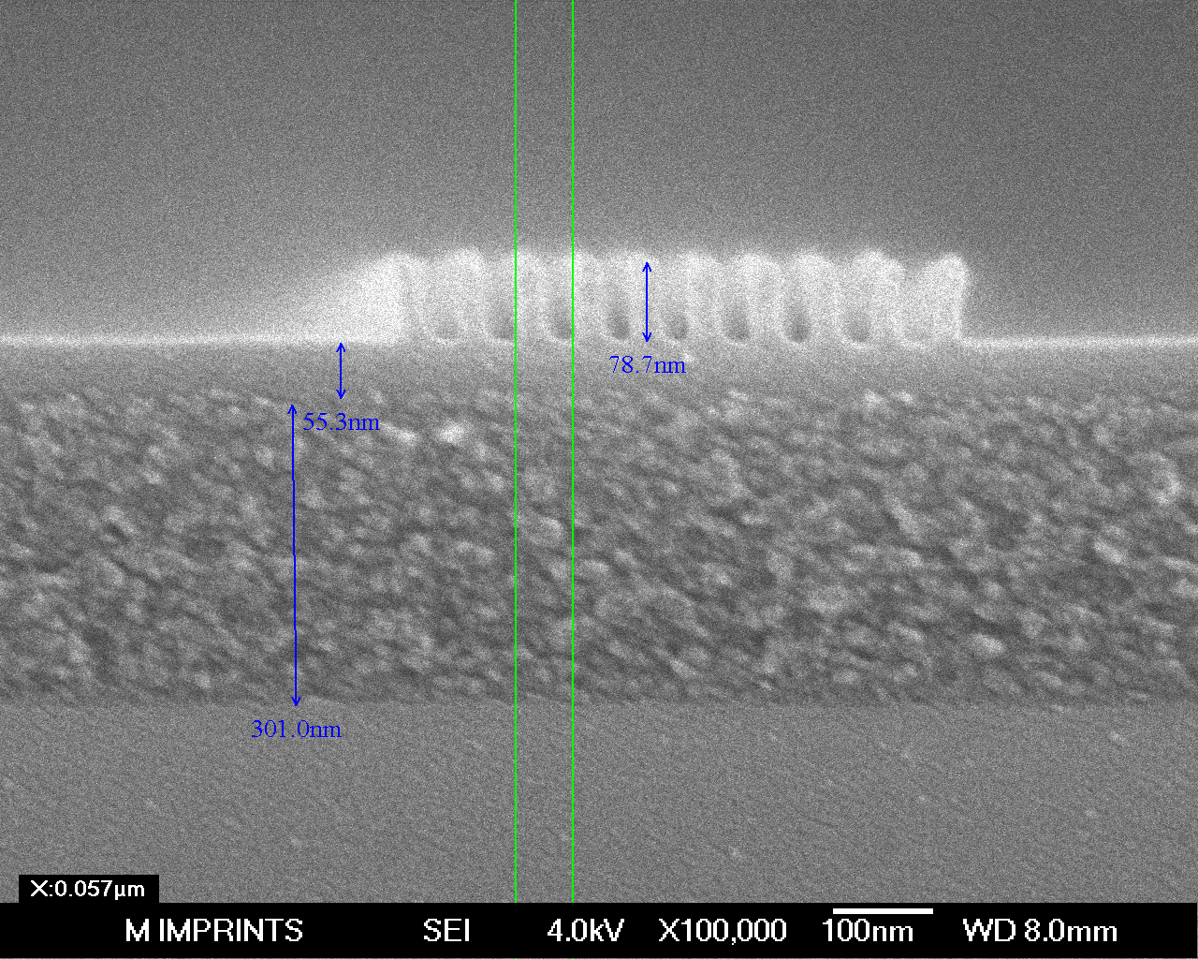
Residual Layer Thickness Measurements
Early Results
Residual layer mean <20nm and thickness variation to < 6 nm TIR
28 nm HP
Residual layer thickness fully populated wafer

Slide 19
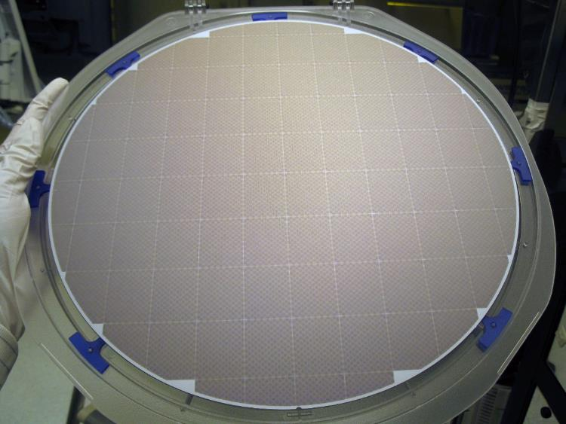
Residual Layer Control Today
Software and hardware have been developed to correctly jet resist, and control the spreading of the resist.

Slide 20
1) Why do you think 1X projection lithography replaced contact printing in the early 80’s?? Don’t you learn from history??
2) Do you propose attempt to do lithography without a pellicle??!!
Defects

Slide 21
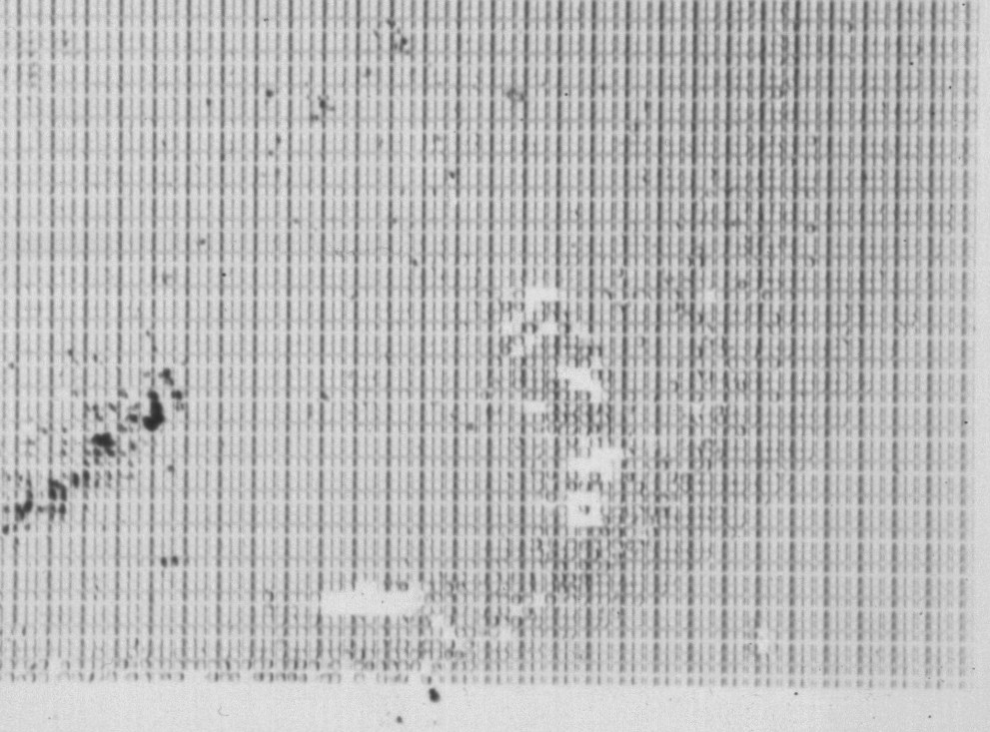
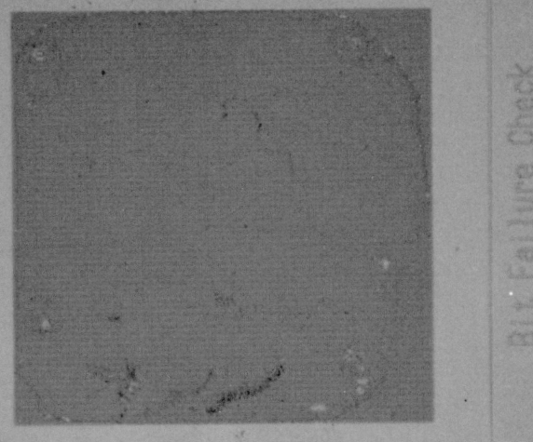
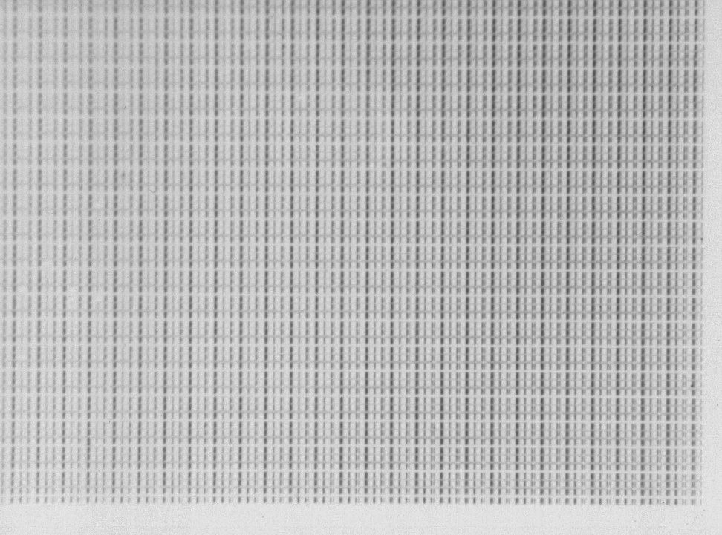
Template Before and After Imprints
Filthy
Template
Template after second imprint
Template prior to imprint
All visible defects disappear from
the template.
Printing is the best way to clean
an SFIL template!
This is our “Pellicle”

Slide 22
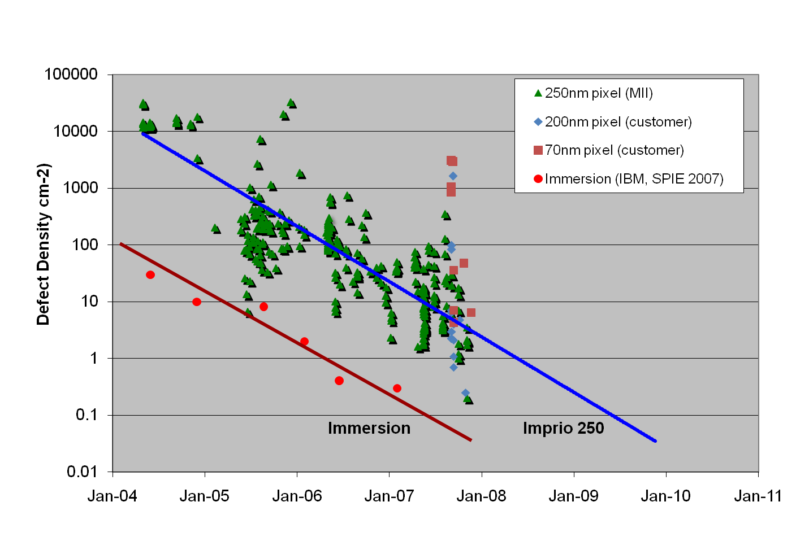
Defect Density Trend Similar to Immersion….early work
Data measured on imprinted wafers – includes all sources of defects
Steady improvement in defect density –
Rate approximately one order of magnitude per year
  very similar to immersion lithography learning curve

Slide 23
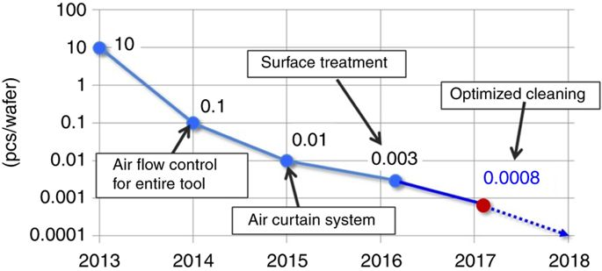
Defect Control in the current Canon Tool
1 particle / 2500 wafers ☺!

Slide 24
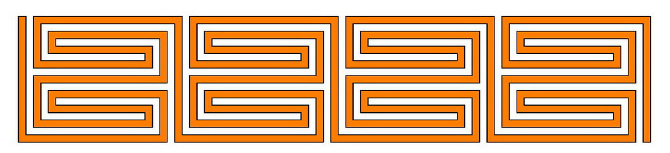
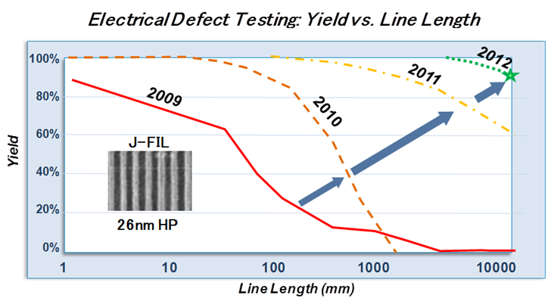
Electrical Testing for Defectivity
Serpentine conductor testing

Slide 25
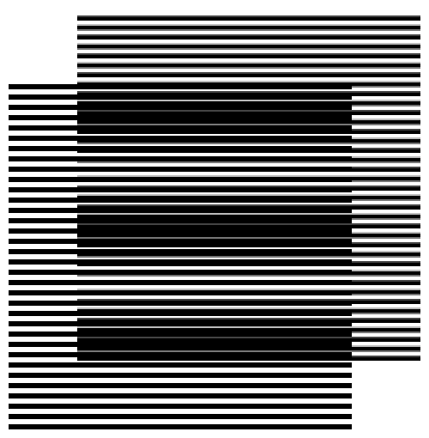
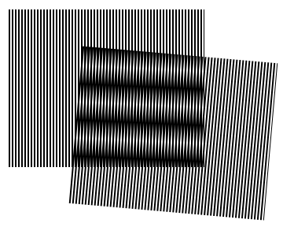
Field-To-Field Alignment
Moiré metrology originally developed for X-Ray litho (Smith, Moon)
  Sub-nanometer resolution, inclined optics
  Insensitive to film thickness variations
Alignment and scale/shape correction are performed “in-liquid” which is typically a 15nm residual layer
25

Slide 26
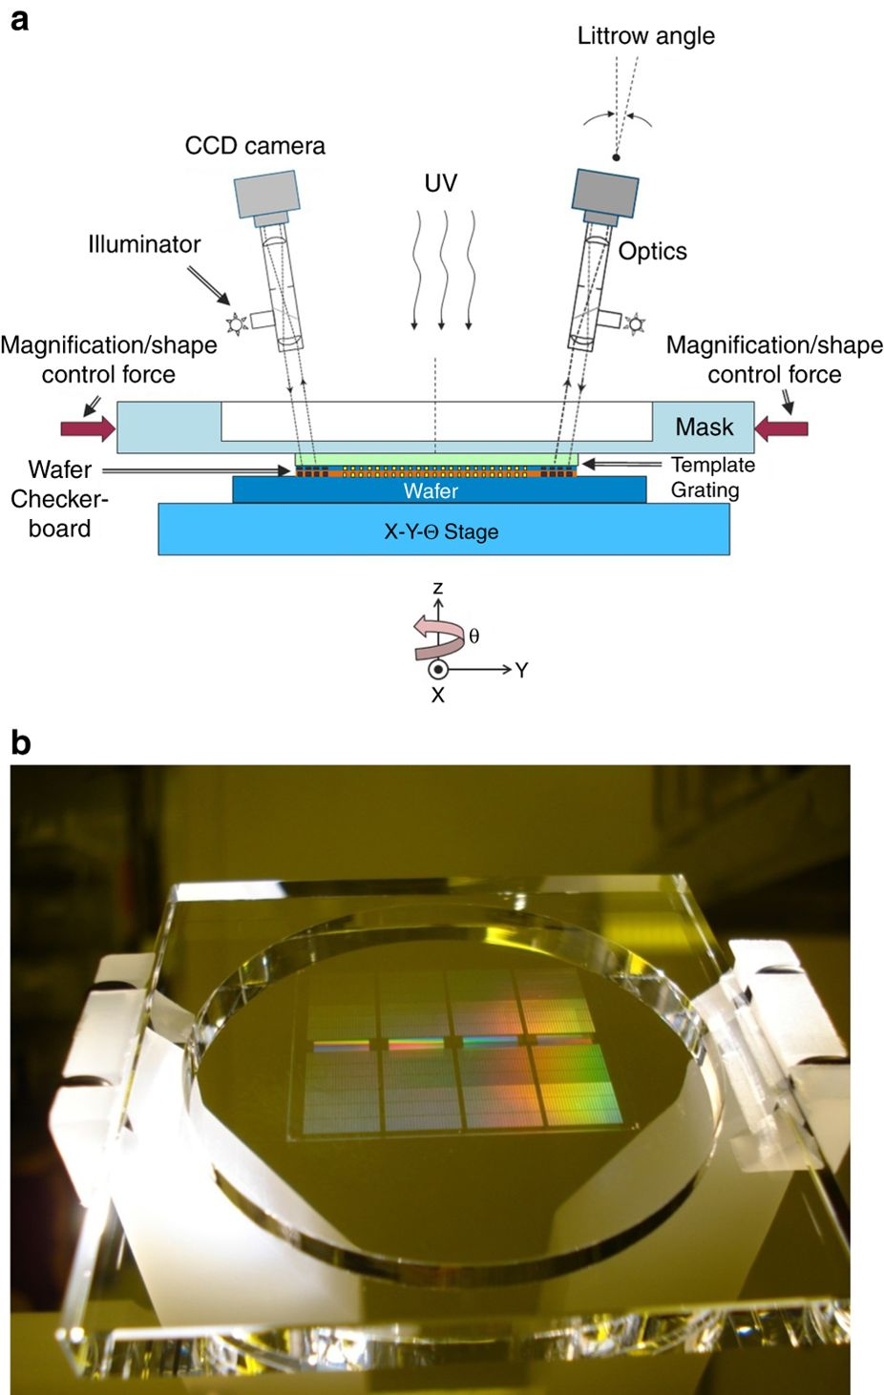

Slide 27
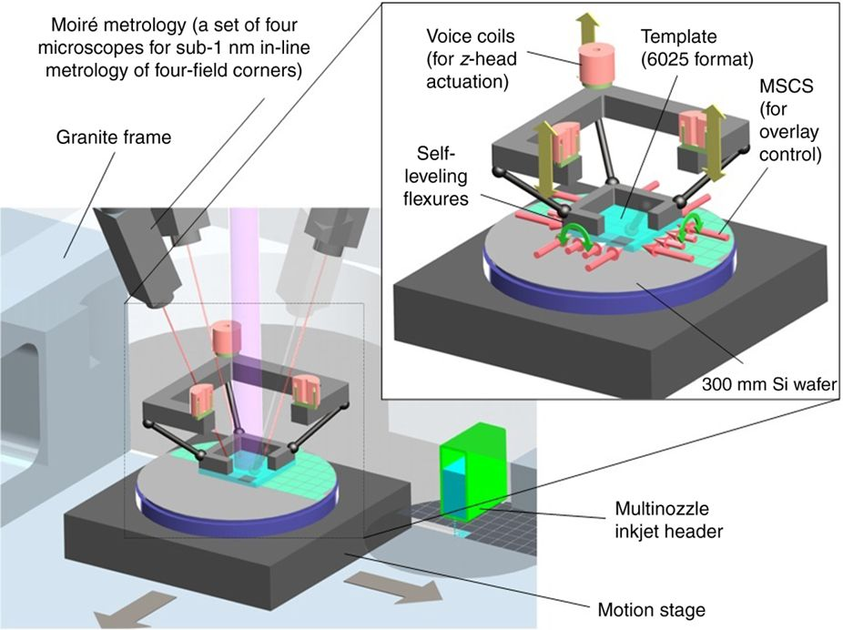

Slide 28
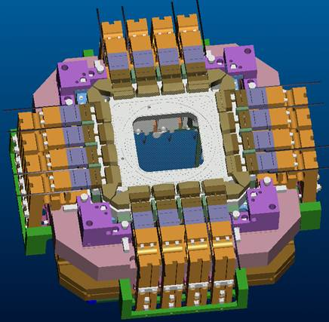
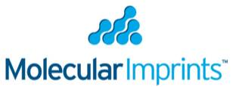
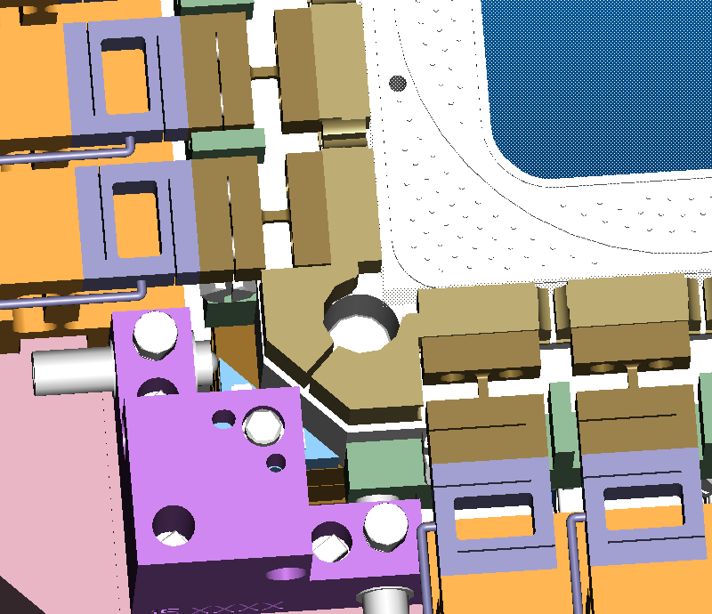
Overlay: Scale/Shape Correction Mechanism
Loadcell
Pads
Gimbal
SiC Chuck & Template
28

Slide 29
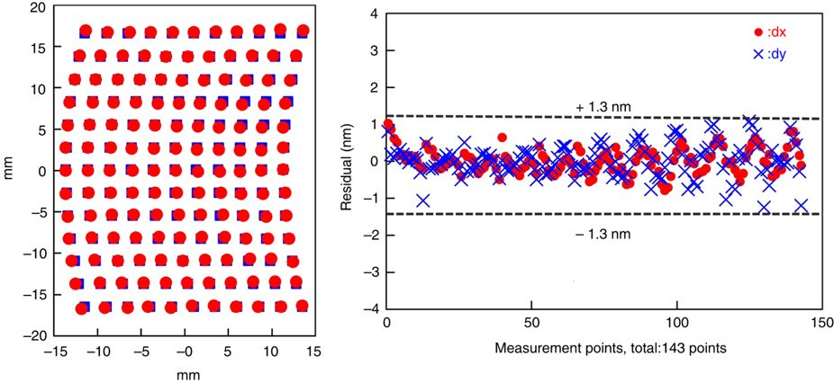
High Order Corrections

Slide 30
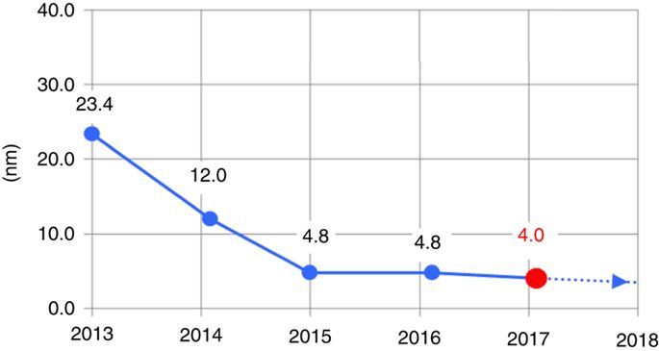
3 sigma alignment SFIL to 193 nm Optical

Slide 32
Throughput
Full Wafer printing is not possible now
  Here alignment is the issue
Fill time is the rate limiting step
  Control of dispense pattern
  Resist material design
Engineering the separation step
  Minimize defects
  Maximize template life time

Slide 33
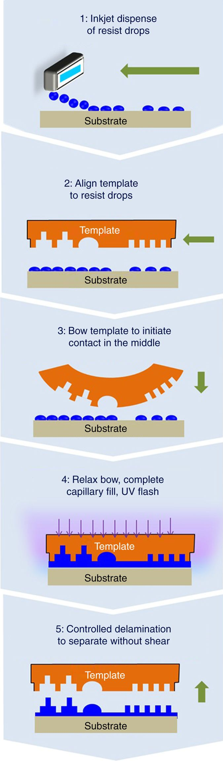
The Fill Step
Adaptive dispense, spread and release in 1.5 sec

Slide 34
The Fill Step

Slide 35
The Fill Step

Slide 36
The Fill Step

Slide 37
The Fill Step

Slide 38
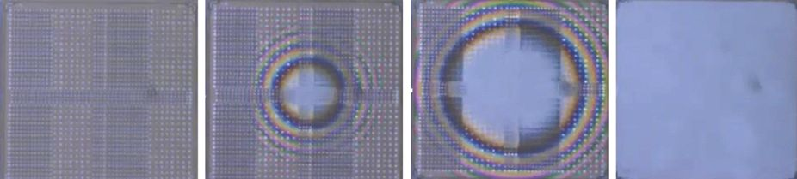
Snap Shots of previous steps

Slide 39
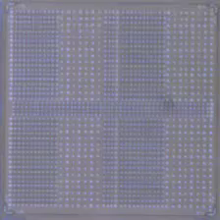
Nanofluidics: RLT Control and High Throughput
High density
Low Density
Drop dispense addresses template geometry variation, pattern-specific directionality of flow, multi-scale fluid/solid mechanics, etc. Need to solve inverse problem.
√
Med Density
39

